Slide 1


22-1-2-2599
P4 Traffic Classification
Guy Davidi & Amit Davidi
Supervisor: Stefan Chulski
Company: MARVELL
Supervisor approval: _________

Slide 2
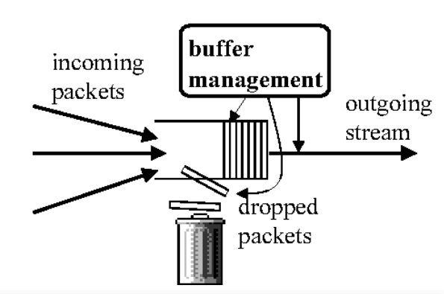
22-1-2-2599
Abstract
The Problem we want to solve:
When too many packets arrive at the switch faster than they can be processed and forwarded, a buffer overflow occurs, which leads to loss of packets, and reduced quality of service.
Goal:
On a Switch, run a packet management algorithm that will classify packets and maximize the data throughput in case of buffer overflow thus increasing QOS.

Slide 3
22-1-2-2599
What is a switch?
A device that processes and forwards data packets between devices on a LAN (Local Area Network) by using MAC (Media Access Control) addresses.
The Switch’s Pipeline is the process that the switch uses to process and forward data packets, this pipeline is made of stages.
Emulating a Switch: will enable us to
pass packets through the switch (and test the throughput) (via Marvell’s packet generator).
Configure the switch’s pipeline with a top-down paradigm (via the new technology: P4)
Test different packet management algorithms easily (such as – buffer overflow management algorithms and packet classification algorithms)

Slide 4
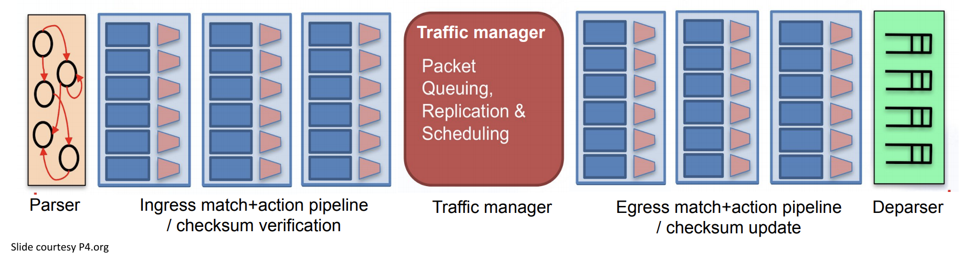
22-1-2-2599
What is a switch?
Switch’s Pipeline:

Slide 5
22-1-2-2599
How are we going to achieve our goals?
Problem: Having a Configurable Software switch
Solution: DPDK (overview next slide)
Problem: Configuring the Switch (pipeline) to implement Different algorithms.
Solution: P4 & p4c (overview next slide)
Problem: Validation
Solution: Packet generator – generate and pass packets into the
Switch, log the throughput of our algorithms.

Slide 6
22-1-2-2599
DPDK
The Data Plane Development Kit (DPDK) is an open-source software project managed by the Linux Foundation. It provides a set of data plane libraries and network interface controller polling-mode drivers for offloading TCP packet processing from the operating system kernel to processes running in user space.

Slide 7
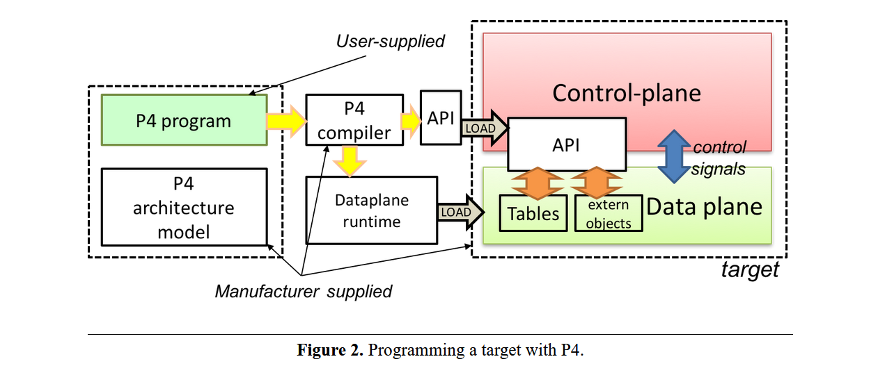
22-1-2-2599
P4, P4 Compiler
P4 is a language for expressing how packets are processed by the data plane of a programmable forwarding element such as a hardware or software switch.

Slide 8
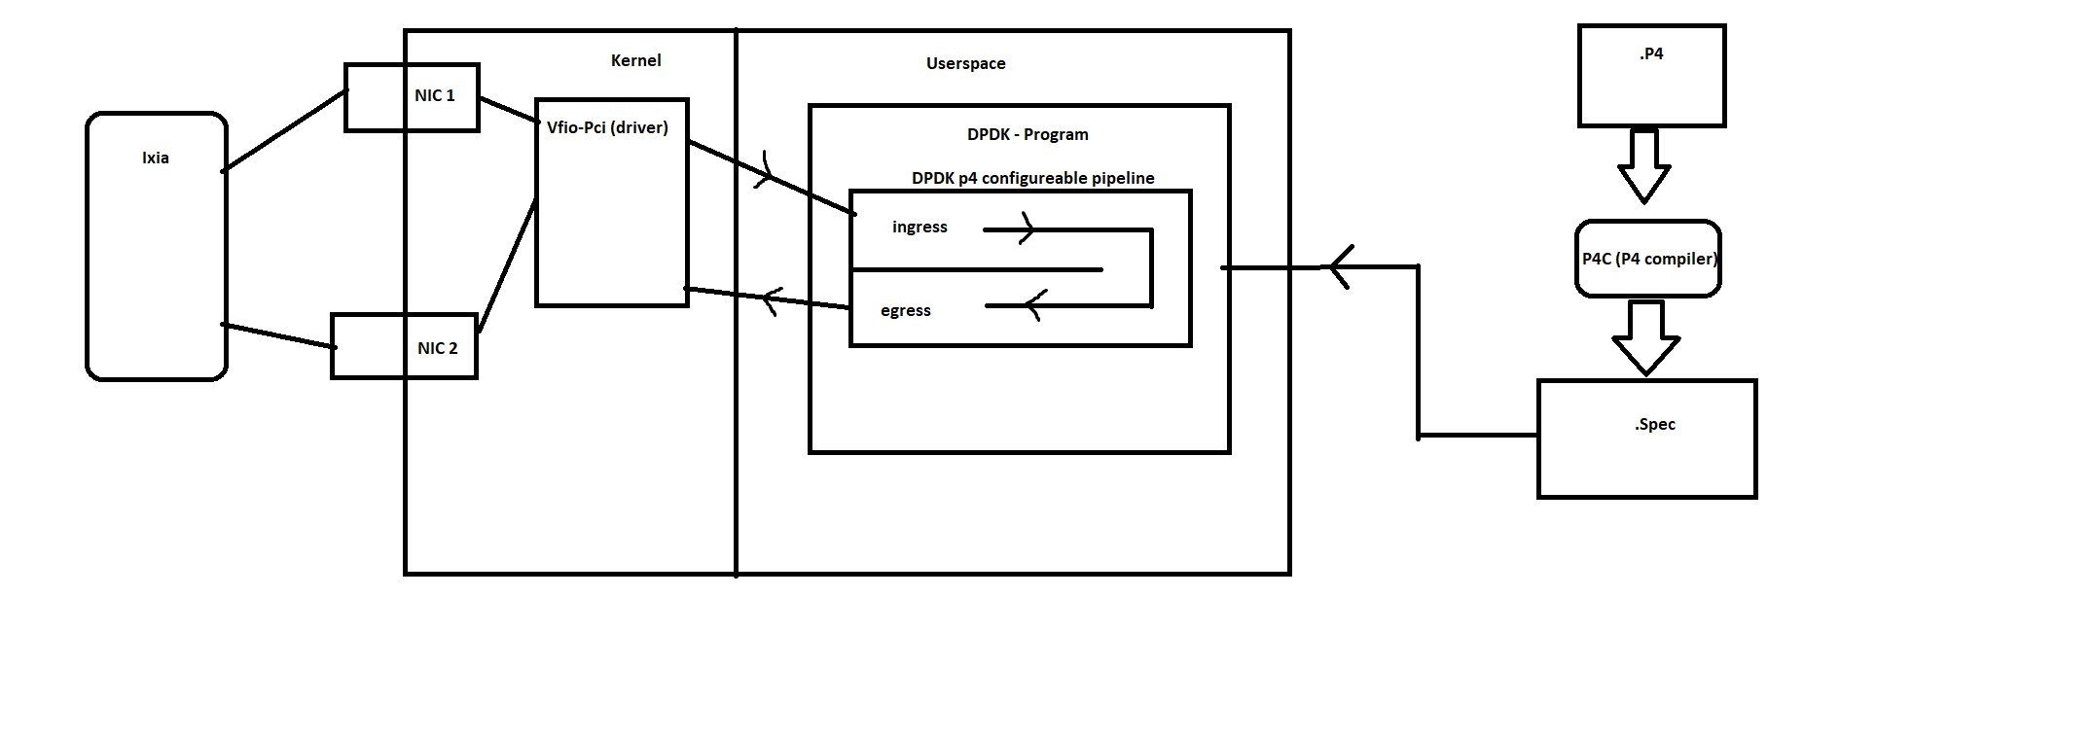
22-1-2-2599
Our topology:
https://github.com/DavidisP4/p4_project
Steps
1. Write a .P4 program that expresses how packets are processed (pipeline)
2. Compile .P4 to .spec using P4C.
3. Configure DPDK software switch Pipeline
Using the .spec
4. Pass packets into the pipeline Using our Packet generator.
5. View and log packet statistics (Throughput, …)

Slide 9
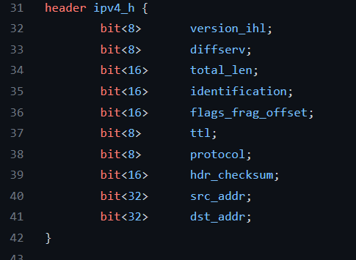
22-1-2-2599
How to configure a pipeline using P4 ?
As we mentioned, the Pipeline has multiple stages, each can be expressed with P4:
Stage 1: The Deparser – produces user-defined data from a stream of bits (Essentially defining our own protocol)
An example for a user-defined `struct` that will hold IPV4 data:

Slide 10
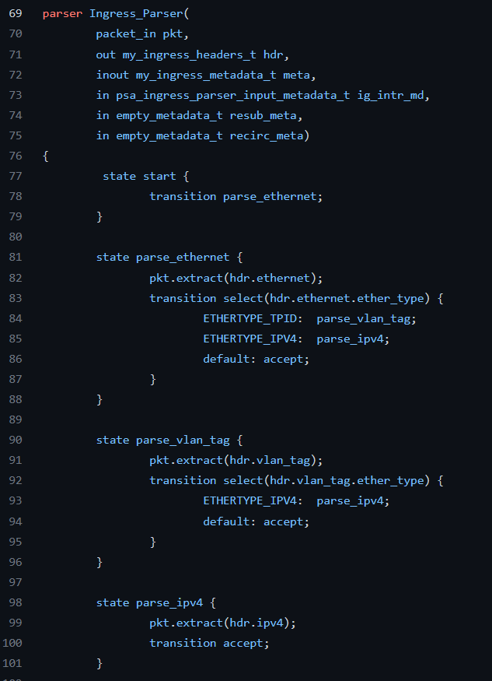
22-1-2-2599
How to configure the pipeline using P4 ?
Stage 1 - Deparser
In this code, If the Packet’s EtherType is ipv4 the parser continues
To the state parse_ipv4 and fills the header we mentioned
before
(The parser can also validate fields or checksum
and raise User-defined errors).

Slide 11
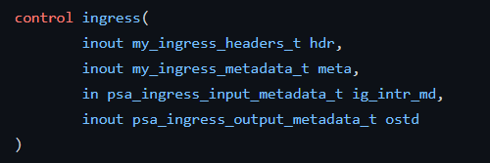
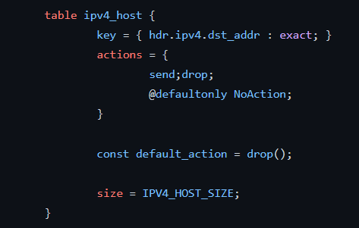
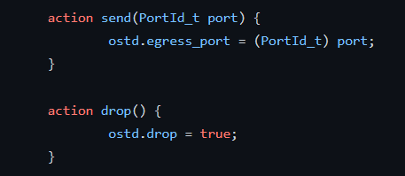
22-1-2-2599
Stage 2 – Match Action, Packet processing
Match action tables can be easily defined in P4:
An example for user defined actions Such as – drop / hop:
An example for a table:
Naming and defining the ingress match-action pipeline
Example for actions:

Slide 12
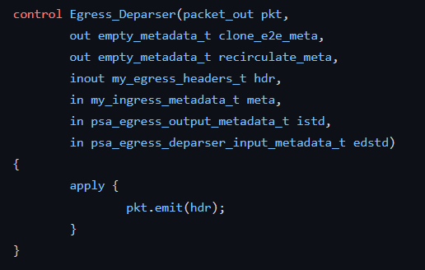
22-1-2-2599
Stage 3 – The deparser: Takes user-defined Data and translates it to bits.
An Example for a deparser:

Slide 13
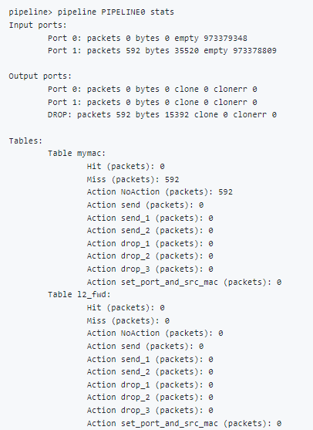
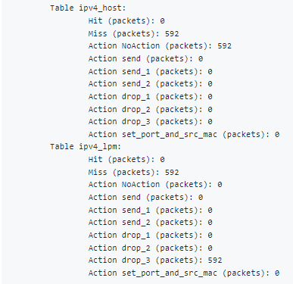
22-1-2-2599
Run DPDK pipeline with Packet generator in background | Telnet window pipeline> pipeline PIPELINE0 stats
DPDK's uses NICs, Bind DPDK driver to device sudo ./dpdk-devbind.py -b vfio-pci 0000:03:00.0 sudo ./dpdk-devbind.py -b vfio-pci 0000:07:00.0 Compilation p4c-dpdk --arch psa l3.p4 -o l2fwd.spec Run sudo ./dpdk-pipeline -c 0x3 -- -s l2fwd.cli CLI is the commands that pipeline trigger

Slide 14
22-1-2-2599
Q & A

